Slide 1

Week 8
MGMT2094 Tut Activity
Innovation and Group Innovation project

Slide 2
Worst ideas
In your project groups
Come up with at least 10 worst ideas
From those worst ideas as a group come up and work on some not so bad ideas that could work.
E.g. Hair in a Can

Slide 3

Questioning Assumptions
The initial issue is:
We need to increase the sales of new 4WD utes to women
What assumptions do we need o make to be successful?

Slide 4
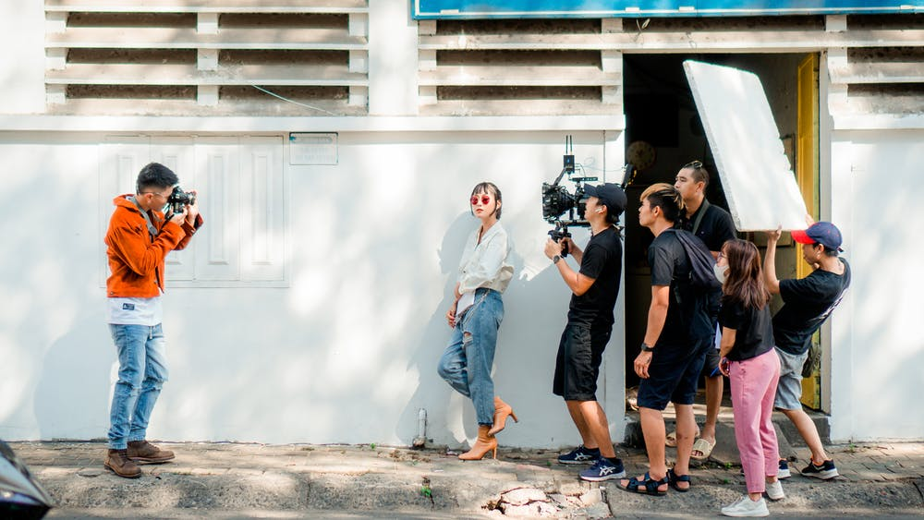
Group Innovation Project
In your group discuss with your tutor what your idea is ?
Remember this is due via a Video presentation by Week 11.

